Slide 1
Bank Marketing Campaign Analysis: Customer Segmentation for Term Deposit Telemarketing
Raymond Arifianto Jonathan

Slide 2
Problem Understanding

Slide 3
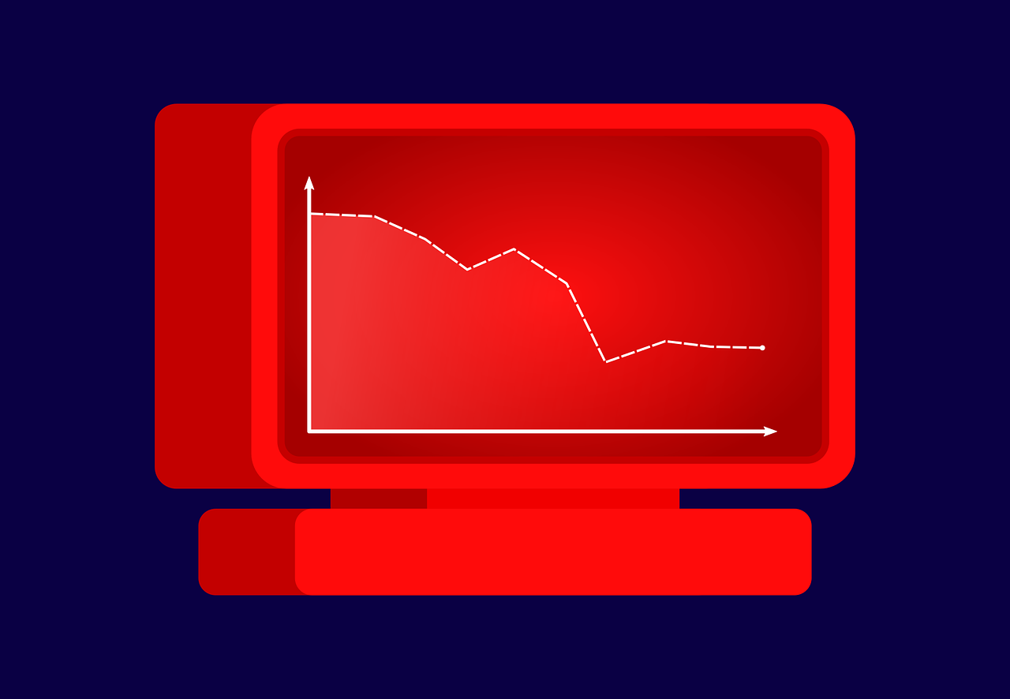
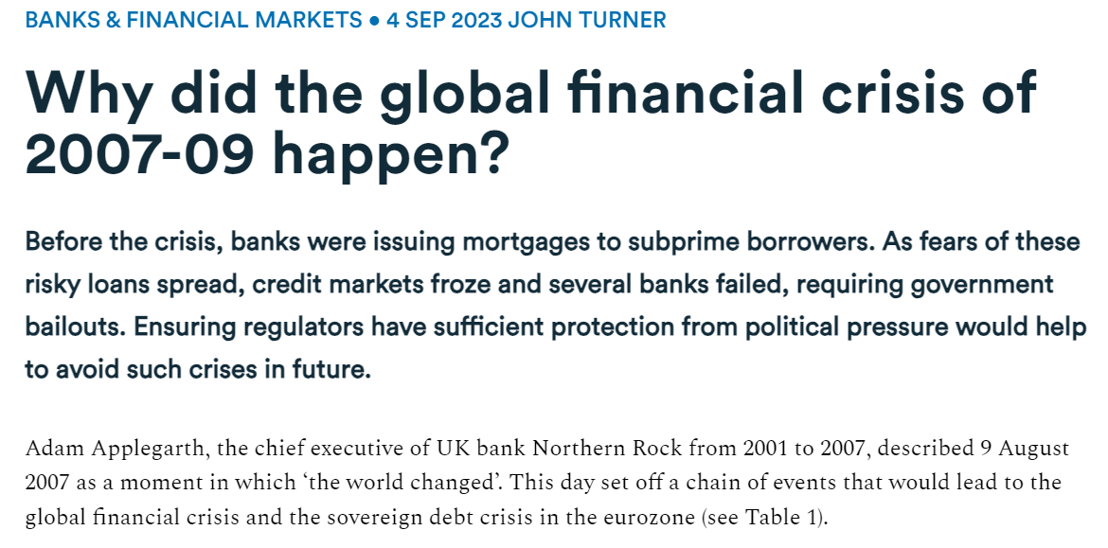
Problem Understanding Context
Context
The 2007 - 2008 financial crisis aftermath
European banks pressured to increase regulatory capital to honor withdrawal
Bank XYZ aims to sell more term deposits
Image by Jan from Pixabay
Source: https://www.economicsobservatory.com/why-did-the-global-financial-crisis-of-2007-09-happen

Slide 4
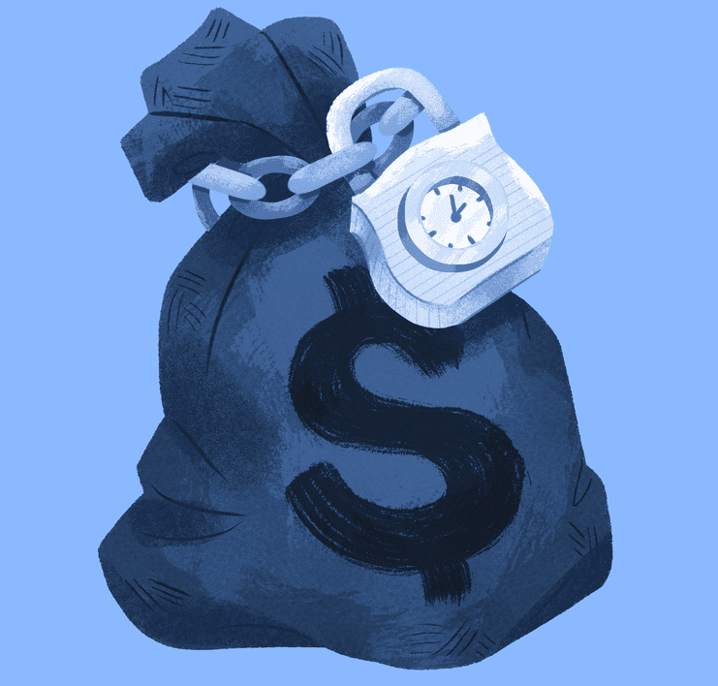
Problem Understanding Problem Statement
Definition of Term Deposits
Fixed term investment
Clients stores money in an account and cannot withdraw until fixed term expires
Better interest rate than savings
Typically minimum of 500 euros
References :
Bikker J. A. & Gerritsen D. F. (2018). Determinants of Interest Rates on Time Deposits and Savings Accounts: Macro Factors, Bank Risk, and Account Features. International Review of Finance, 18(2), 169-216
https://www.investopedia.com/terms/t/termdeposit.asp

Slide 5
Problem Understanding Objective
Bank XYZ Objective
Identify which clients are more likely to subscribe to term deposits
Discover the most important characteristics that influence clients’ interest to subscribe to term deposits
ML objective
Build a classification model that can correctly classify target variable (y), where:
‘yes’ is class 1 : Successful. Client subscribed.
‘no’ is class 0 : Not successful. Client did not subscribe.

Slide 6
Problem Understanding Metric Evaluation
Type 1 error : False Positive
Consequence :
Loss from unnecessary telemarketing efforts (time, manpower, budget)
Type 2 error: False Negative
Consequence :
Losing potential customers
According to problem statement,
Increase regulatory capital through sales of term deposits
minimize false negatives (missing out on potential customers)
Cost of making calls is very low due to cheap bundling options
false positives is not a huge issue
Evaluation Metrics:
Focus on recall to minimize false negatives
f1 score and precision-recall threshold curves will be used to maintain an acceptable level of precision.

Slide 7

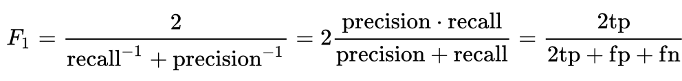
Problem Understanding Metric Evaluation – Recall and f1 Score
recall is the true positives out of all real positives
f1 score is the harmonic mean of recall and precision
Credits: Retrieved from https://en.wikipedia.org/wiki/F-score
“Precision and recall” by Walber is licensed under CC BY-SA 4.0. Retrieved from https://en.wikipedia.org/wiki/Precision_and_recall

Slide 8
Data Understanding

Slide 9
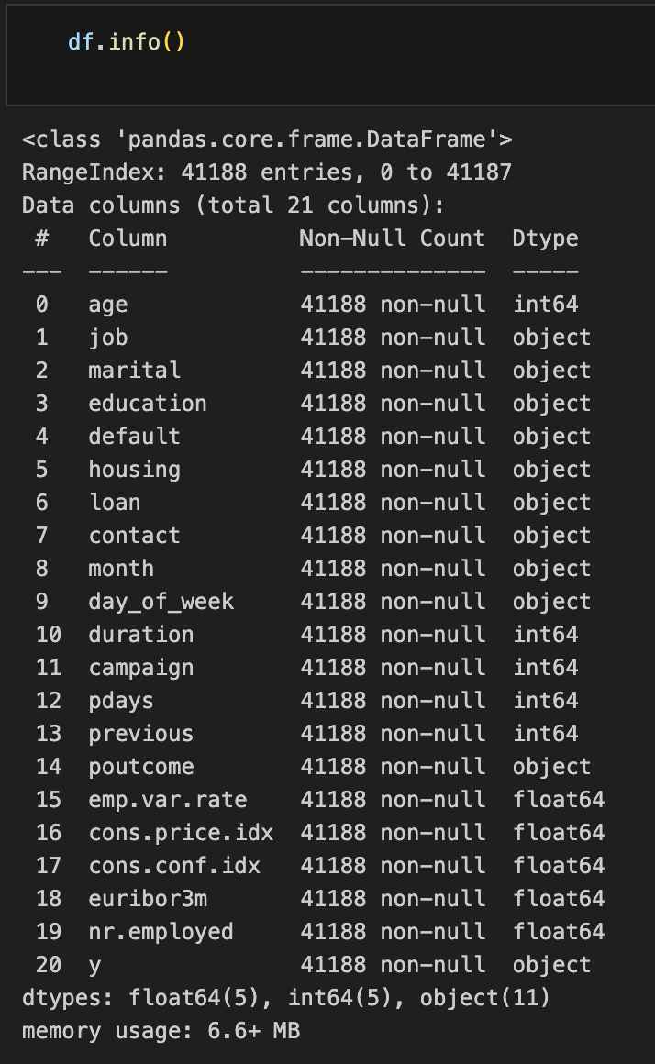
Data Understanding Data Size and Type
41,118 rows : 41,118 clients (including duplicates)
21 columns : 20 features and 1 target variable
10 quantitative and 11 categorical
Type | Sub-type | Features
Numerical / Quantitative | Continuous | age, duration, pdays, emp.var.rate, cons.price.idx, cons.conf.idx, euribor3m
 | Discrete | campaign, previous, nr.employed
Categorical | Ordinal | education
 | Nominal | job, marital, default, housing, loan, contact, month, day_of_week, poutcome
 | Binary | y (Target Variable)

Slide 10
Data Understanding - Features Client Demographic and Credit History
Type | Feature | Description | No. of Unique Values
Quantitative | age | Client’s age | 78
Categorical | job | Client’s job | 12
 | marital | Client’s marital status | 4
 | education | Client’s education level | 8
 | default | Does the client have credit in default? | 3
 | housing | Does the client have housing loan? | 3
 | loan | Does the client have personal loan? | 3

Slide 11
Data Understanding - Features Last Contact with Client
Type | Feature | Description | No. of Unique Values
Quantitative | duration | Duration, in seconds, of last contact call | 1544
Categorical | month | Month of last contact | 10
 | day_of_week | Day of week of last contact | 5
 | contact | Communication channel with client | 2

Slide 12
Data Understanding - Features Previous Communications / Campaigns
Type | Feature | Description | No. of Unique Values
Quantitative | campaign | Number of times the client was contacted during this campaign, including last contact | 42
 | pdays | Number of days since the client was last contacted during a previous campaign *999 means not contacted | 27
 | previous | Total number of times the client was contacted before this campaign | 8
Categorical | poutcome | Outcome of previous campaign | 3

Slide 13
Data Understanding - Features Economic Indices
Feature | Indicator Period | Description | No. of Unique Values
emp.var.rate | Quarterly | Employment Variation Rate : Change in employment rate | 10
cons.price.idx | Monthly | Consumer Price Index : Measure of inflation by calculating average price for selection of goods and services | 26
cons.conf.idx | Monthly | Consumer Confidence Index : Poll of consumers’ level of optimism towards current and expected financial situation | 26
euribor3m | Daily | Euribor 3 Month Rate : Interbank lending rate | 316
nr.employed | Quarterly | Average of the Total Number of Employed Citizens | 11
References :
https://www.investopedia.com/terms/c/consumerpriceindex.asp
https://www.investopedia.com/terms/c/cci.asp
https://www.santander.com/en/stories/what-is-the-euribor-and-why-should-we-be-interested#:~:text=The%20top%20banks%20in%20the,%25%2C%20which%20gives%20the%20Euribor.

Slide 14
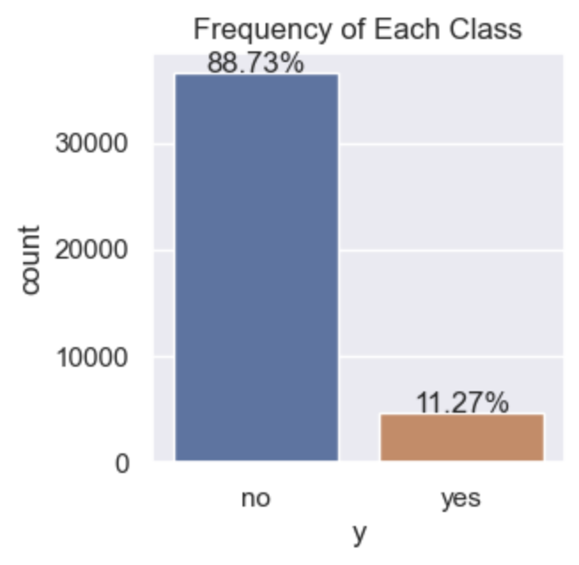
Data Understanding Class Balance of Target Variable
Findings
The classes are imbalanced.
Approximately 11% yes (class 1) and 89% no (class 0)
Need to explore using undersampling and oversampling techniques during modeling

Slide 15
Exploratory Data Analysis (EDA) for Data Cleaning

Slide 16
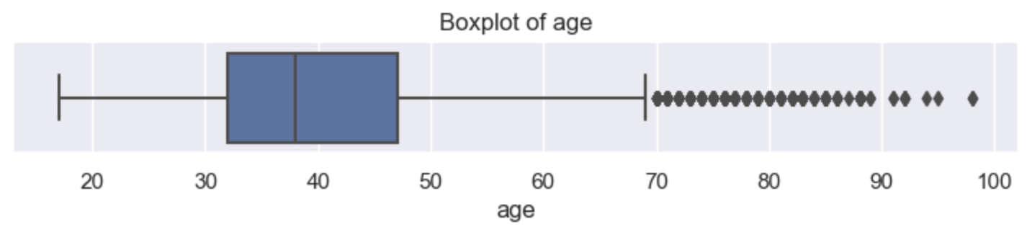
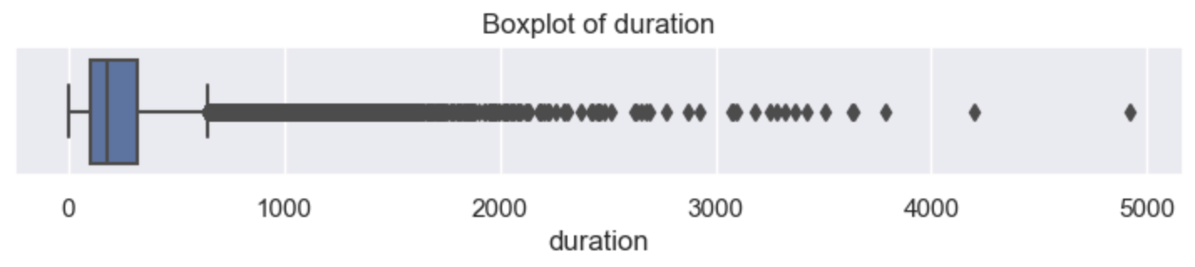
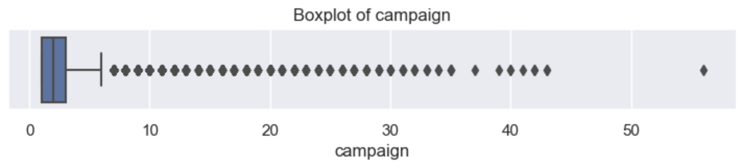
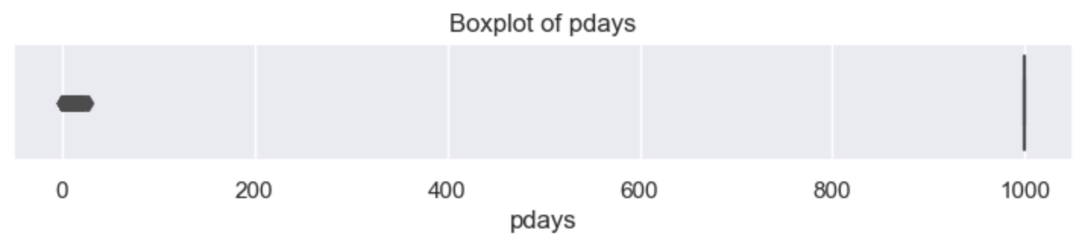
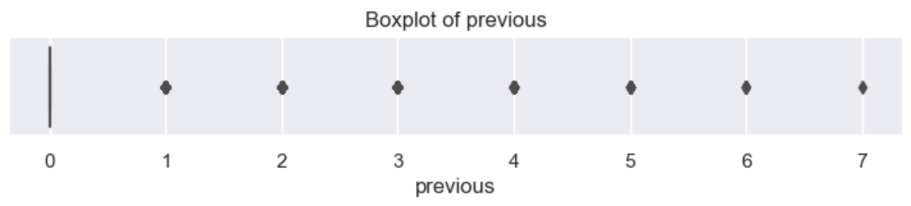
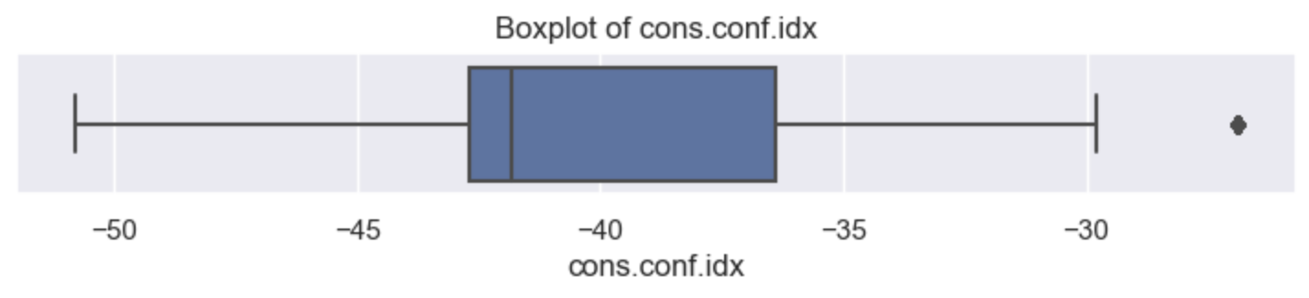
EDA for Data Cleaning Quantitative Data
Objective
Identify outliers
Quick overview of distribution to understand how to handle these anomalies
Findings
Outliers in age, duration, campaign, pdays, previous, cons.conf.idx
In pdays, 999 means not contacted previously and comprise 87% of column values

Slide 17
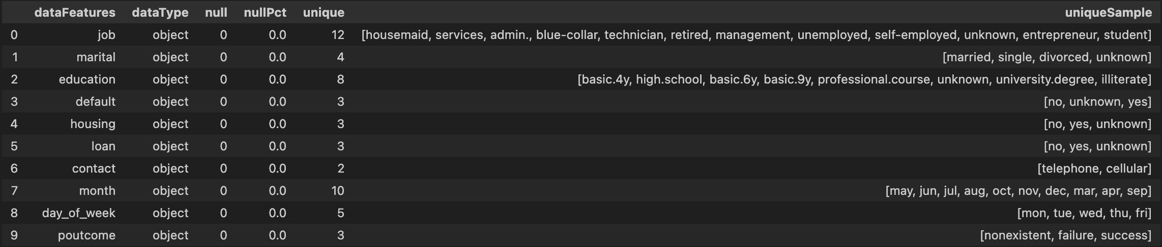
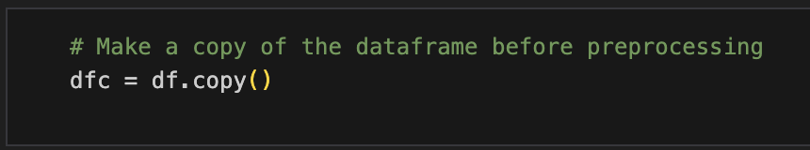
EDA for Data Cleaning Categorical Data
Objective
Identify missing values or anomalies
Findings
‘unknown’ in job, marital, education, default, housing and loan
‘nonexistent’ in poutcome
Next, handle duplicates, missing values and outliers but make a dataframe copy first

Slide 18
Data Cleaning I Missing Values

Slide 19
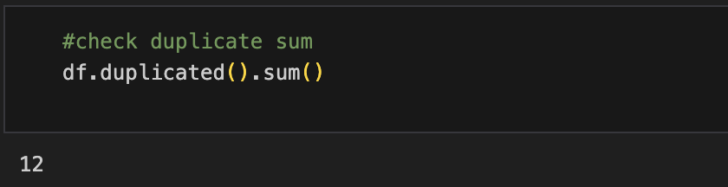
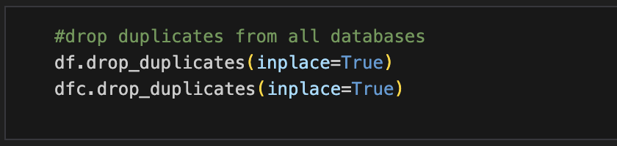
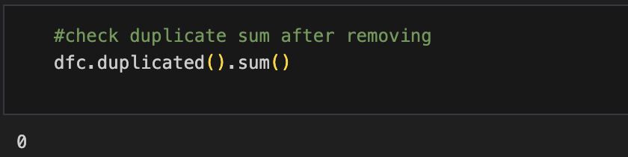
Data Cleaning Duplicates
Findings
There are only 12 duplicate rows.
Solution
Drop all duplicates

Slide 20
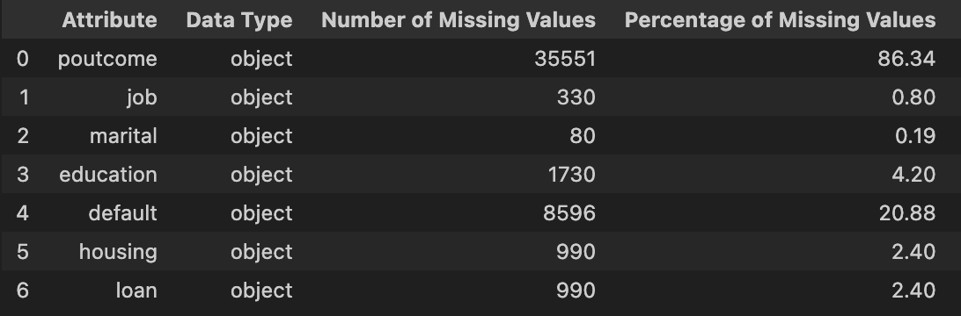
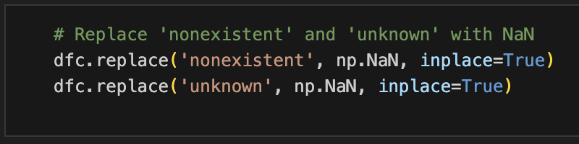
Data Cleaning - Missing Values Proportion
Findings
poutcome contains the highest proportion of missing values (86.34%), followed by default (20.88%).
marital and job have the smallest proportion of missing values (less than 1%).
education, housing and loan have between 2 - 5% missing values.
Treat ‘unknown’ and ‘nonexistent’ as missing values

Slide 21
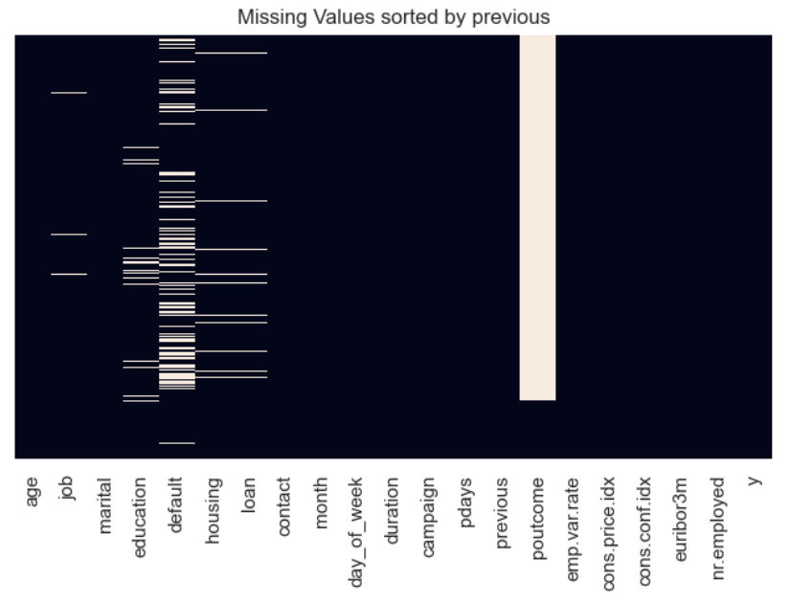
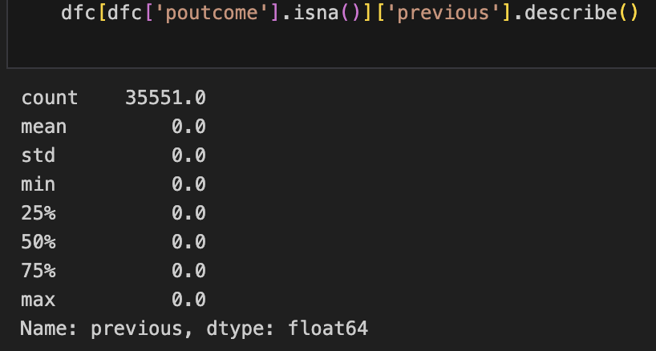
Data Cleaning - Missing Values ‘poutcome’
Proportion of Missing Values : 86.34%
Findings
Values for previous feature are all 0 for missing/nonexistent values in poutcome
Hence, nonexistent means clients who have not been contacted in a previous campaign before.
Solution
Missing values will be filled with ‘p_not_contacted’.
Findings
Missing values in poutcome are related to previous
Missing at Random (MAR)

Slide 22
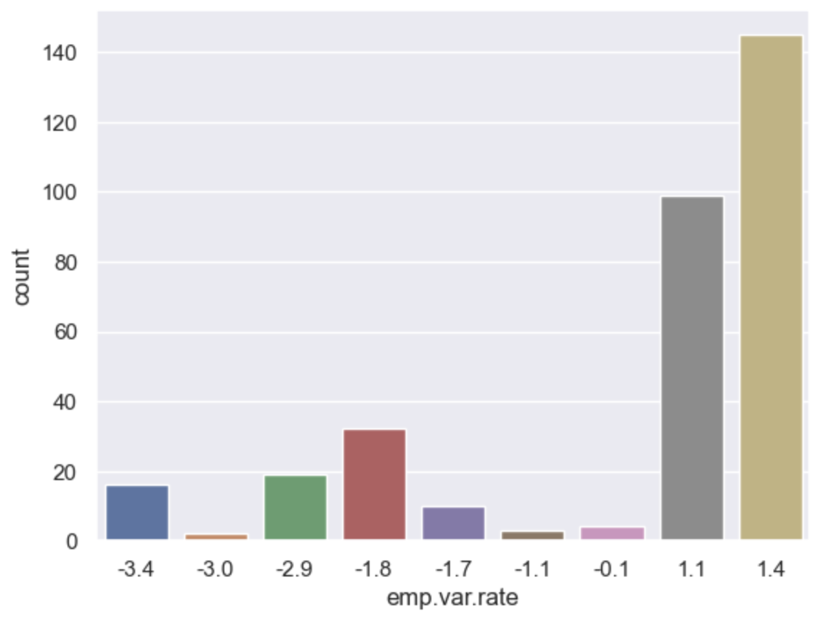
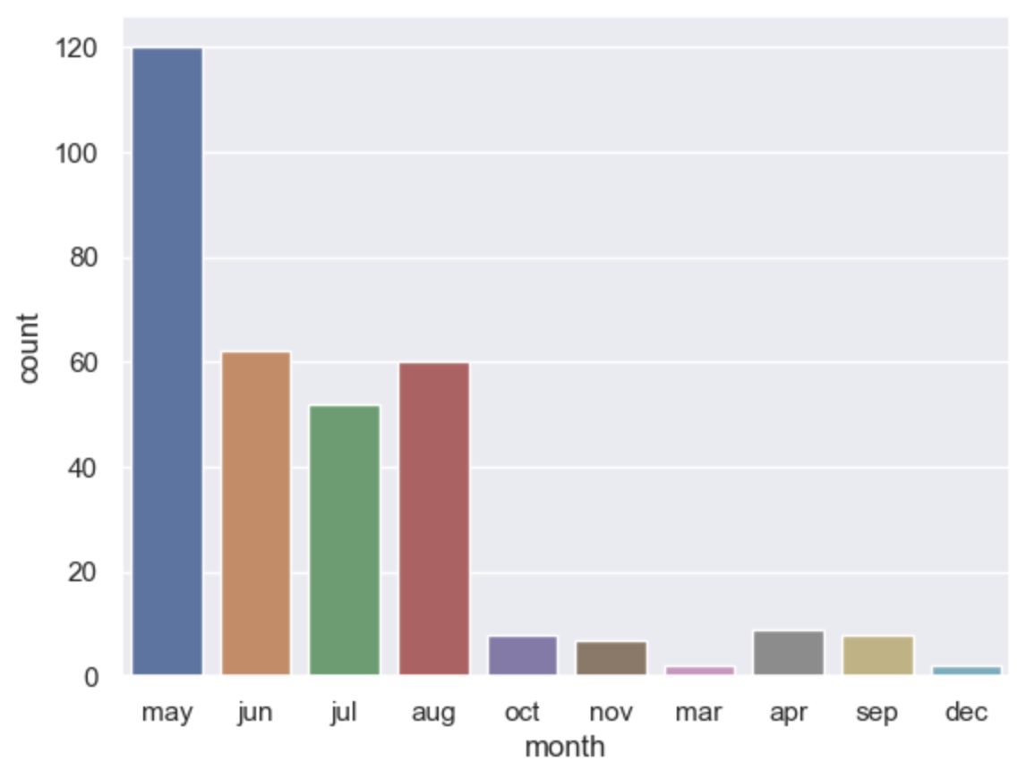
Data Cleaning - Missing Values ‘job’
Proportion of Missing Values : 0.80%
Bar plot of emp.var.rate of missing values of job
Bar plot of month of missing values of job
Findings
Missing values in job are related to emp.var.rate and month, hence, Missing at Random (MAR)
Findings
Missing values in job occur most frequently at emp.var.rate of >=1.1 and on the month of May

Slide 23
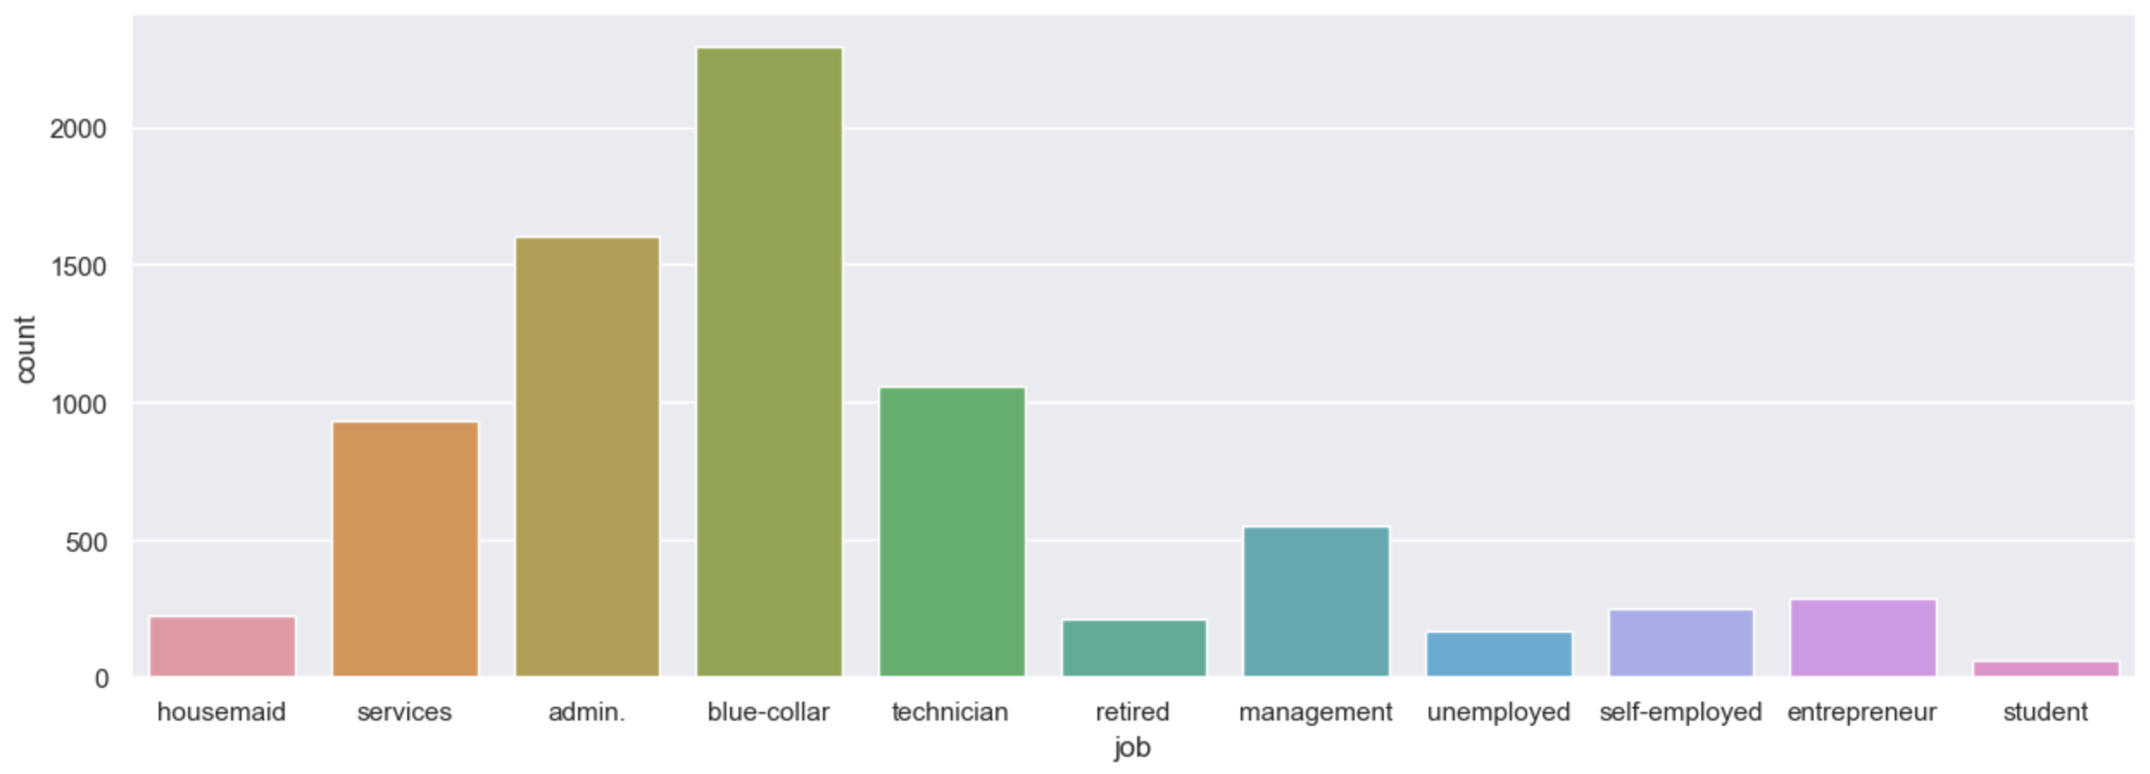
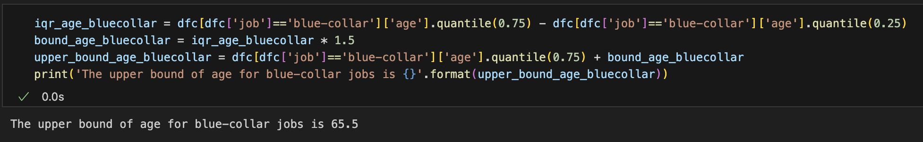
Data Cleaning - Missing Values ‘job’
Proportion of Missing Values : 0.80%
Bar plot of job when emp.var.rate >=1.1 and month == May
Findings
Missing values in job occur most frequently at emp.var.rate of >=1.1 and on the month of May
‘blue-collar’ is the mode
Solution
Fill missing values of job with ‘blue-collar’ for age <= 65.5 and ‘retired’ for ages above that
Upper bound of age of blue-collar

Slide 24
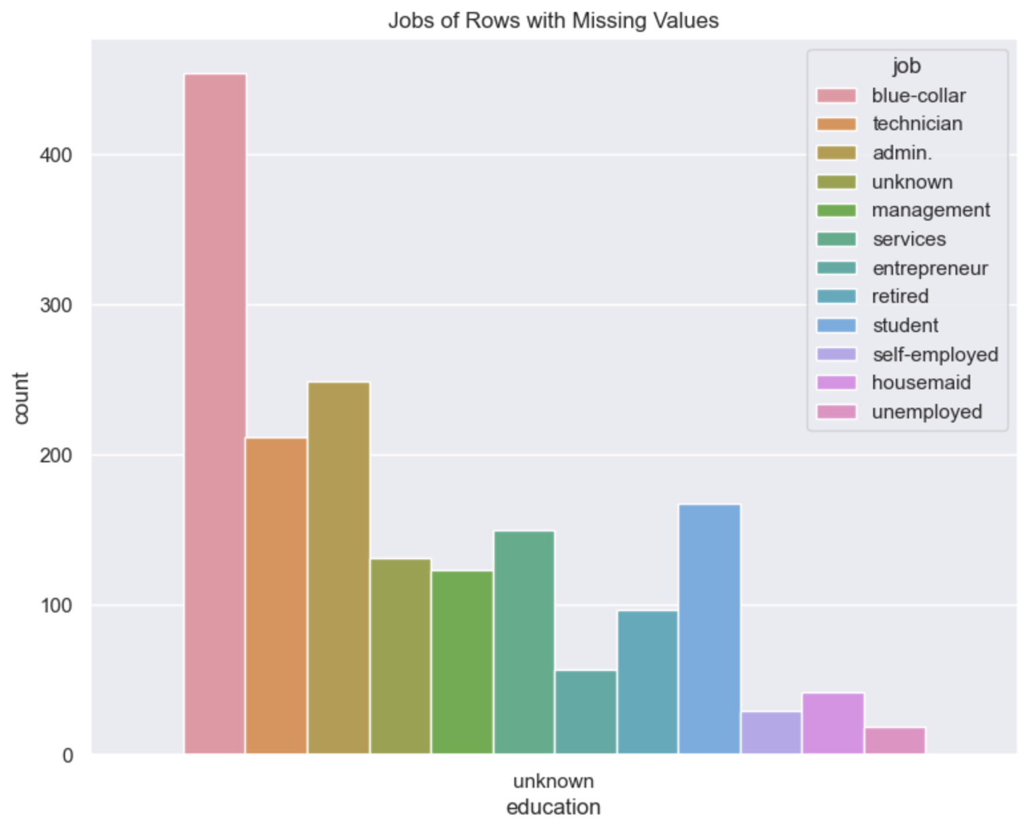
Data Cleaning - Missing Values ‘education’
Proportion of Missing Values : 4.20%
Findings
Most of the missing values in education have jobs as
‘blue-collar’
‘technician’
‘admin’
‘entrepreneur’ and ’student’

Slide 25
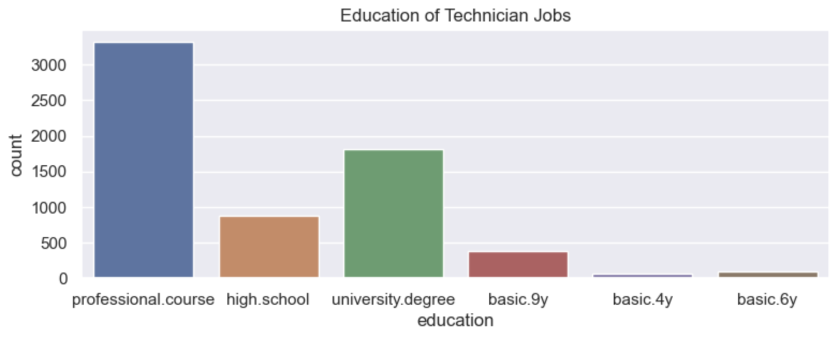
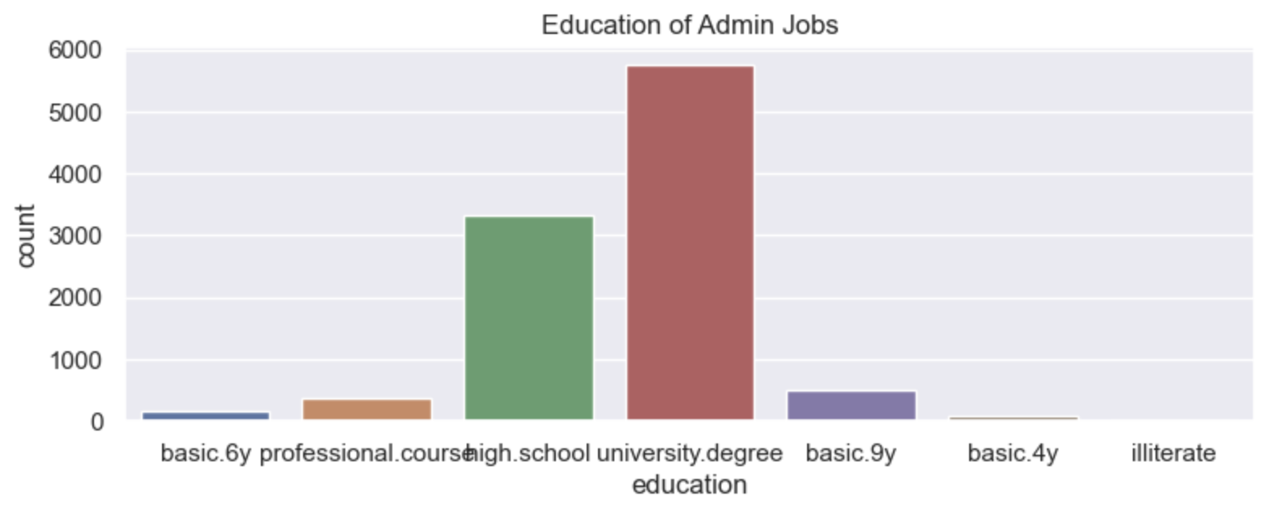
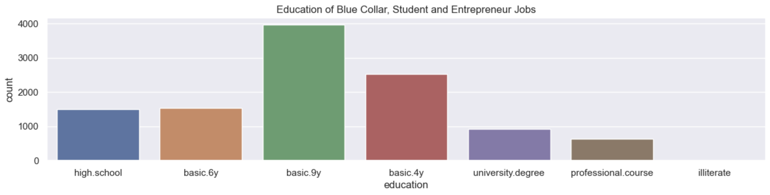
Data Cleaning - Missing Values ‘education’
Proportion of Missing Values : 4.20%
Mode for ‘technician’ job is ‘professional.course’.
Mode for ‘admin’ job is ‘university.degree’.
Mode for ‘blue-collar’, ‘student’ and ‘entrepreneur’ job is ‘basic.9y’.

Slide 26
Data Cleaning - Missing Values ‘education’
Proportion of Missing Values : 4.20%
Solution
Fill missing values in education with education mode of each job :
‘technician’ job with mode of ‘technician’ job : ‘professional.course’
‘admin.’ job with mode of ‘technician’ job : ‘university.degree’
remaining missing values with
mode of ‘blue.collar’, ‘student’ and ‘entrepreneur’ : ‘basic.9y’

Slide 27
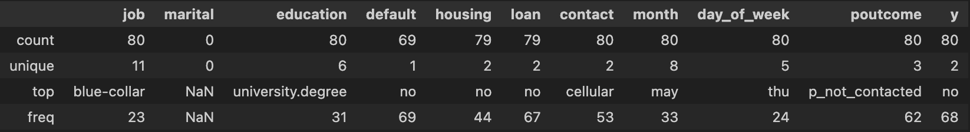
Data Cleaning - Missing Values ‘marital’
Proportion of Missing Values : 0.19%
Findings
From the statistical summary and missing values heatmap, marital values cannot be explained by other features. Hence, Missing Completely at Random (MCAR)
The proportion of missing/unknown values is also low (0.19%).
Solution
Drop the rows containing missing/unknown values for marital.

Slide 28
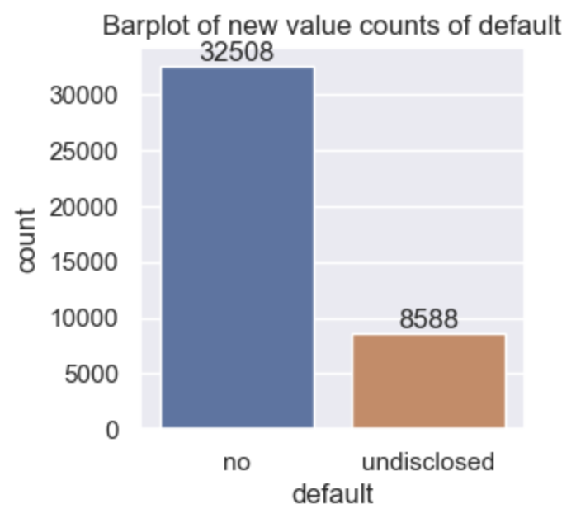
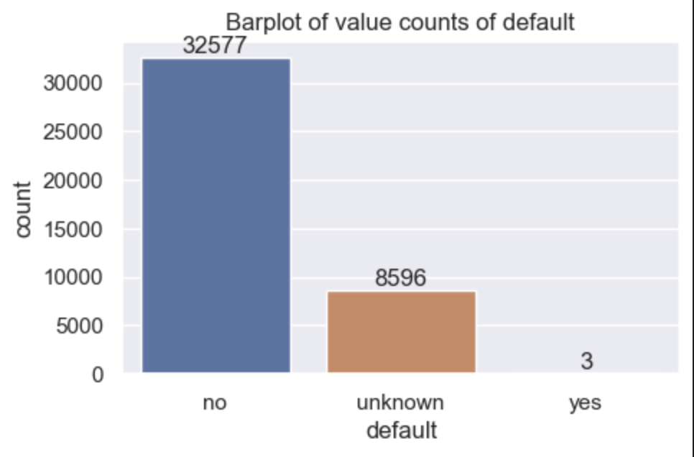
Data Cleaning - Missing Values ‘default’
Proportion of Missing Values : 20.88%
Findings
Only 3 counts of ‘yes’
Most likely, customers are not willing to disclose due to sensitivity
Solution
Merge column values of ‘unknown’ and ‘yes’ into ‘undisclosed’ to get binary

Slide 29
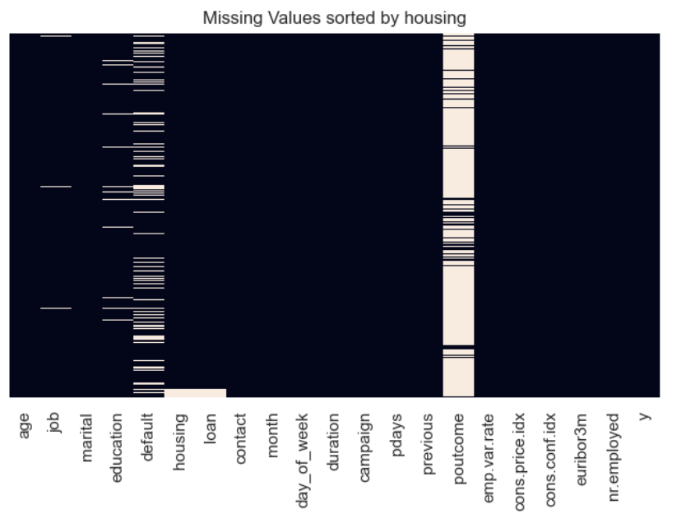
Data Cleaning - Missing Values ‘housing’ and ‘loan’
Proportion of Missing Values : 2.40% each
Findings
Housing and loan have identical missing / unknown values
EDA does not reveal proper approach to handle missing values.
Solution
Keep them as ‘unknown’ original values
Will be further discussed later at feature selection

Slide 30
Data Cleaning II Outliers

Slide 31
Data Cleaning - Outliers
From EDA Findings
Outliers present in age, duration, campaign, pdays, previous, cons.conf.idx
cons.conf.idx : economic index, prefer to leave as is
duration : recorded after call so cannot be used
pdays : similar data meaning as previous
*duration and pdays will be discussed more in feature selection
Conclusion
Only handle outliers in age, campaign and previous

Slide 32
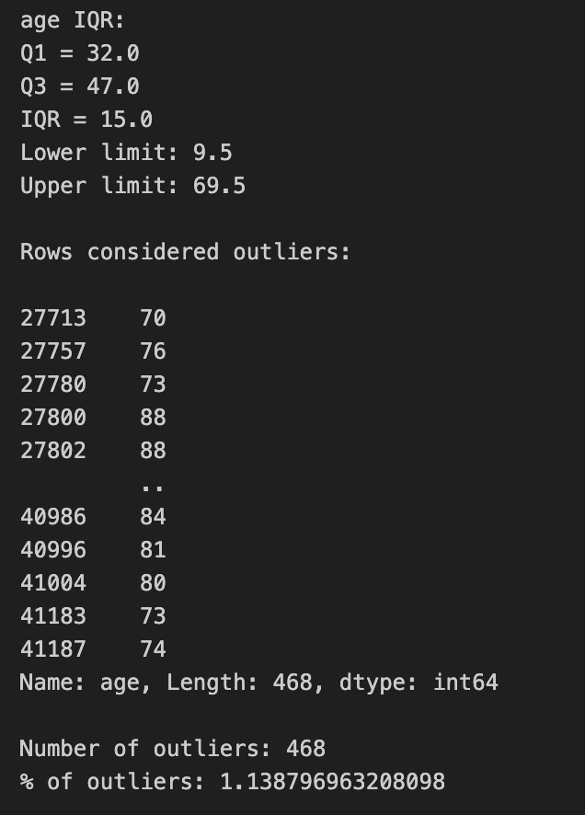
Data Cleaning – Outliers ‘age’
Findings
Low proportion of outliers (about 1%)
69.5 is not too far from the EU expectancy of 81.5*
Solution
Remove outliers
*Source: https://www.euronews.com/next/2023/07/22/life-expectancy-where-in-europe-do-people-live-the-shortest-and-the-longest

Slide 33
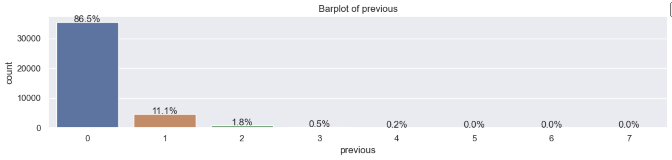
Data Cleaning – Outliers ‘previous’
Findings
87% of values in previous are 0
Solution
Change to binary :
1 : contacted previously and
0 : not contacted previously

Slide 34
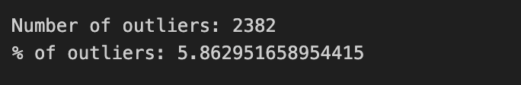
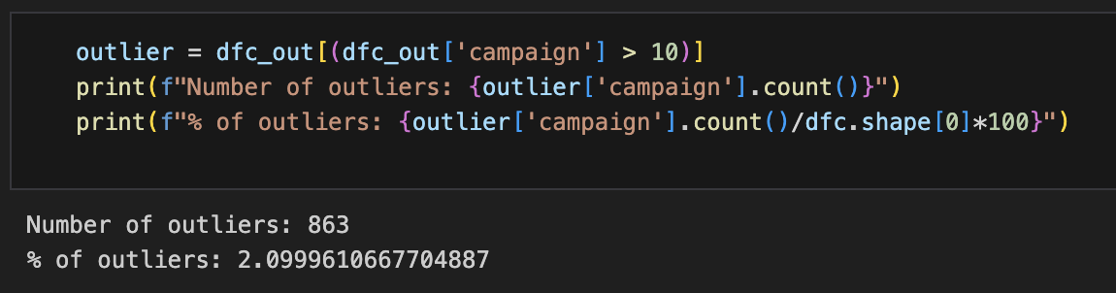
Data Cleaning – Outliers ‘campaign’
Findings
Above the upper bound of 6, there are 5.86% outliers
Adjusting threshold to 10, there are 2% outliers
Solution : Remove values > 10

Slide 35
Data Cleaning III Formatting

Slide 36
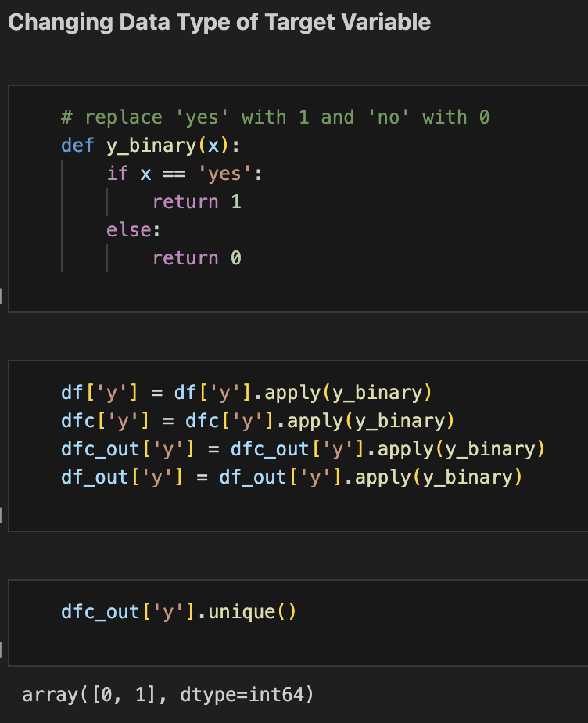
Data Cleaning - Formatting Target Variable
Change target variable value from ‘yes’ to 1
Change target variable value from ‘no’ to 0

Slide 37
Feature Selection and Feature Engineering

Slide 38

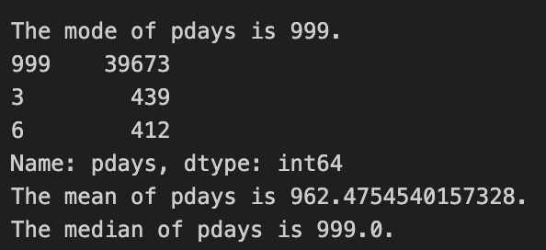
Feature Selection Based on Data Understanding
1. Drop duration
Reason :
duration data is obtained after call, so data cannot be used to predict retrospectively
Image by Gerd Altmann from Pixabay
2. Drop pdays
Reason :
‘999’ means not contacted, information about not contacted/contacted is already in previous
Not accurate to assume a new value for 999

Slide 39
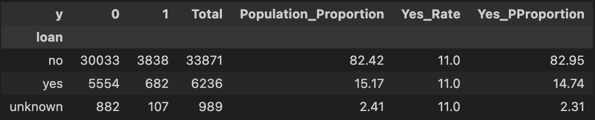
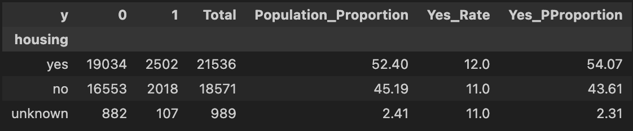
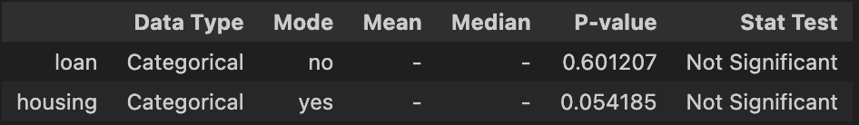
Feature Selection Based on Target Variable
Consider dropping ‘housing’ and ‘loan’
Reason :
Proportion of yes does not vary between ‘yes’, ‘no’ and ‘unknown’
Chi square test result is not significant, hence, cannot reject null hypothesis

Slide 40
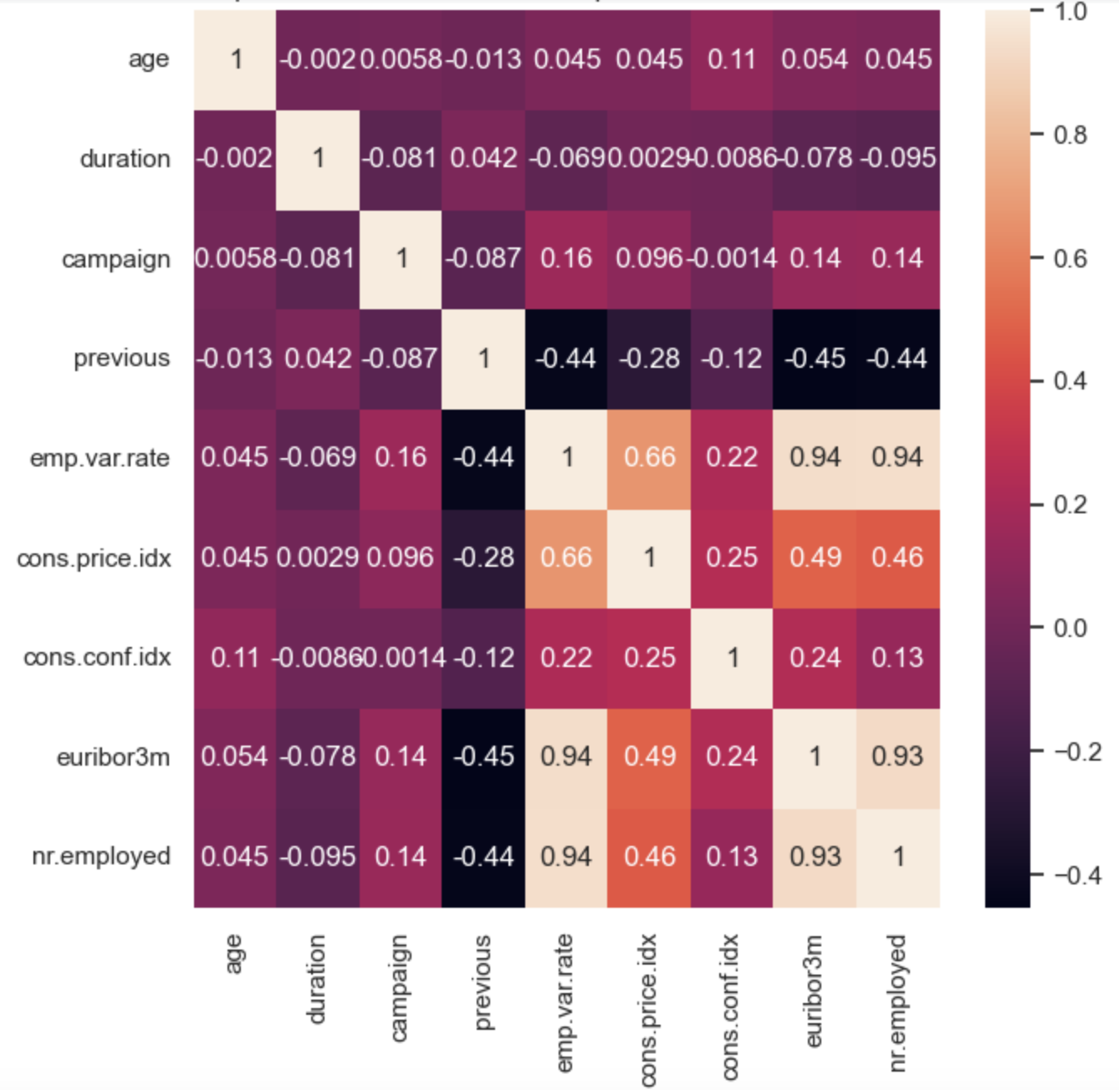
Feature Selection based on Feature Correlation
Consider dropping emp.var.rate, euribor3m and nr.employed
Reason :
High correlation (>0.9) with each other
Moderate correlation (approx. 0.4) with previous and cons.price.idx
Consider keeping either cons.price.idx or cons.conf.idx
Reason :
cons.price.idx and cons.conf.idx have lower correlations with the other econ features and previous
These 2 features can represent the other 3 economic indices

Slide 41
Feature Engineering - Encoding
Table of encoding method used
Type | Subtype | Features | Encoding | Reason
Quantitative | Continuous | age, cons.price.idx, cons.conf.idx, emp.var.rate, euribor3m, nr.employed | Robust Scaler | Outliers
 | Discrete | campaign, previous | None | Already suitable
Categorical | Ordinal | education | Ordinal Encoding | Ordinal subtype
 | Nominal | marital, default, day_of_week, poutcome, default, contact, housing, loan | Onehot Encoding | Low count of unique values (<6)
 | Nominal | job, month | Binary Encoding | High count of unique values (>9)
 | Target Variable | y | None | Already formatted earlier

Slide 42
Modelling & Data Analysis Methodology

Slide 43


Methodology - Modelling
We compare model performances from 5 Dataset Treatments
1. Get Initial Best Model among the following Dataset Treatments:
2. Create Dataset 5 & Compare against Initial Best Model to get Final Model
Dataset 1
Dataset 2
Missing Value Handling
Outlier Handling
Feature Selection
Missing Value Handling
Outlier Handling
Feature Selection
Dataset 5
Initial Best Model’s Dataset Handling
Feature Selection
Dataset 3
Dataset 4
Feature Selection will also take account Initial Best Model’s Feature Importance
Missing Value Handling
Outlier Handling
Feature Selection
Missing Value Handling
Outlier Handling
Feature Selection
3. Evaluate & Analyze Final Model
Note:
Features pdays and duration will not be included in any dataset
Duplicates are removed in all dataset

Slide 44
Methodology – Getting Best Model
Below is the workflow to get the best model:
1. Model Benchmarking
2. Data Rebalancing
3. Hyperparameter Tuning
Decide which Algorithm to use:
Logistic Regression
K-Nearest Neighbour (KNN)
Decision Tree
XGBoost
LightGBM
Random Forest
Try out Data Rebalancing Methods for the Training Dataset:
Random Under Sampler
Random Over Sampler
Over Sampler - SMOTE
Tune the Model parameters to maximize performance

Slide 45
Modelling 1 Initial Best Model
Dataset 1 – 4
Split: 80% Train Set, 20% Test Set

Slide 46
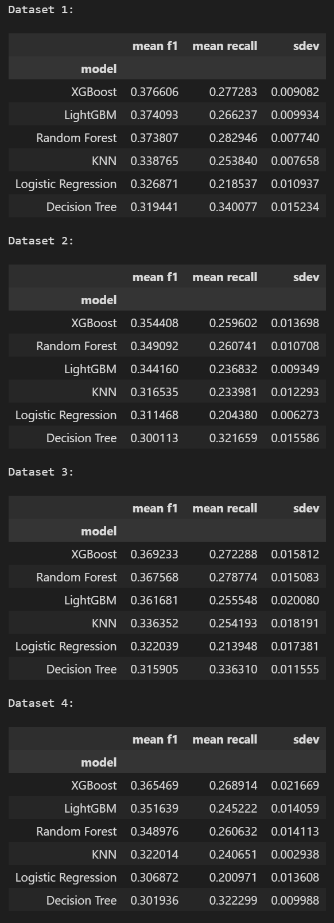
Model Benchmarking Dataset Comparison
Method:
Stratified 5-Fold Cross-Validation
Result:
Dataset 1 outperforms the rest on all algorithms
Handling the Missing Values can make some algorithm perform worse
Removing the outliers universally worsen the performance of any algorithm
Conclusion:
Proceed Modelling with Dataset 1
(no Missing Value & Outlier Handling)
Missing Value Handling
Outlier Handling

Slide 47
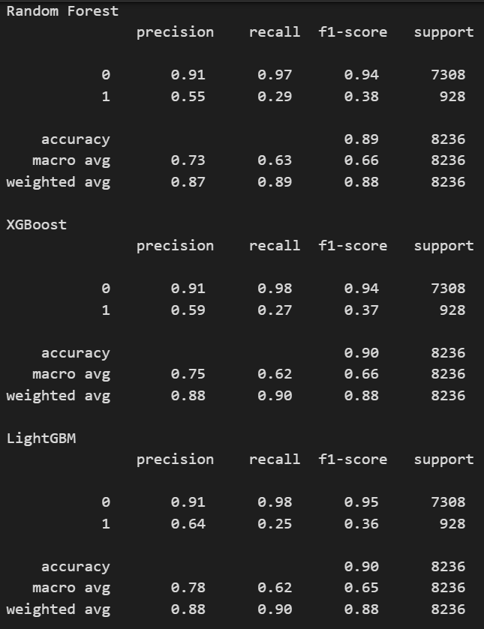
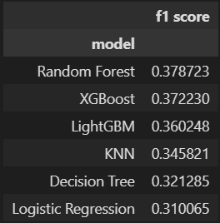
Model Benchmarking Test Data
Dataset Used:
Dataset 1
(no Missing Value & Outlier Handling)
Result:
The Top 3 Algorithms are Random Forest, XGBoost and LightGBM (Consistent with Cross-Validation)
At the Default Threshold (0.5), the max F1-Score is 0.38 with recall of 0.29 using Random Forest
Let’s see the graph of the Top 3 Algorithms:
Precision-Recall Curve
Precision and Recall vs Threshold Curve
F1-Score vs Threshold Curve

Slide 48
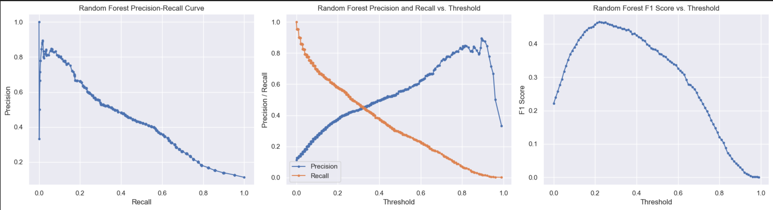
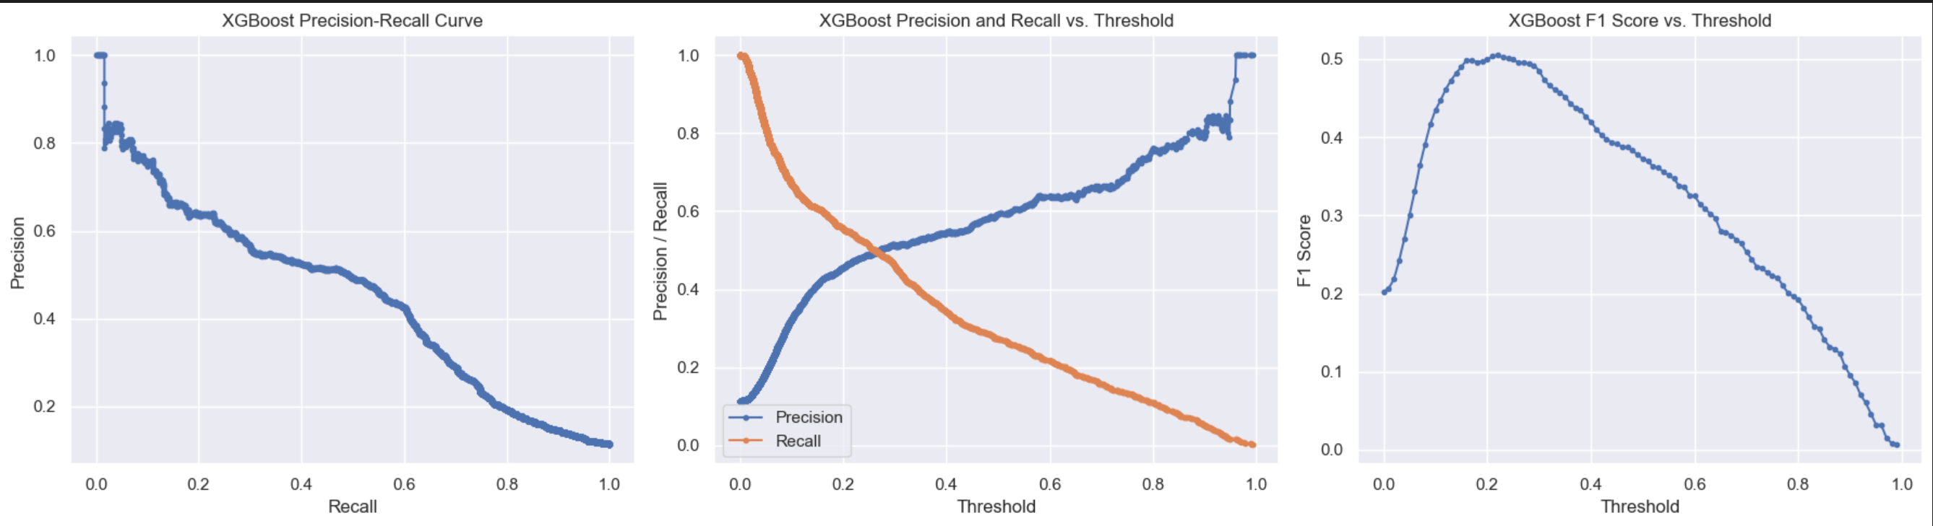
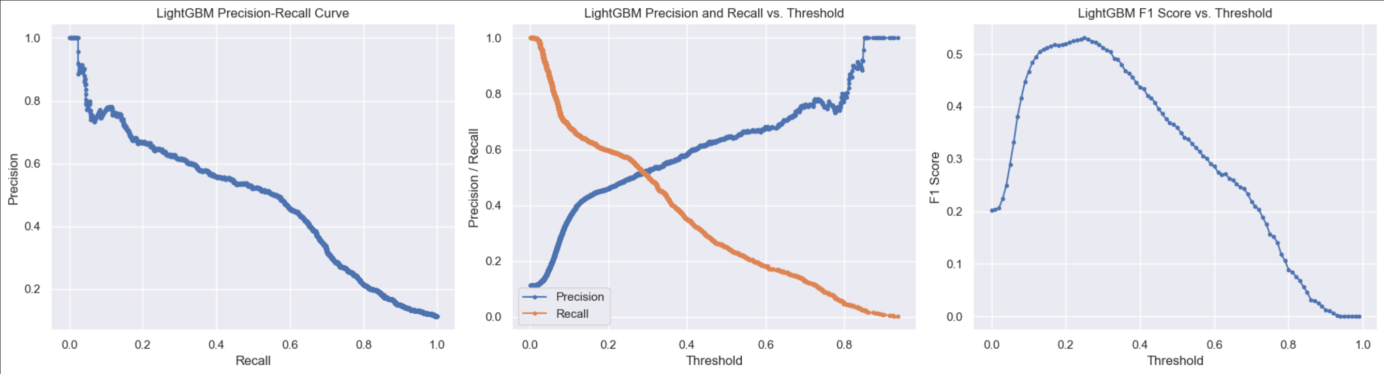
Model Benchmarking Test Data – Graph Comparison
1
Random Forest peaked at ~ 0.45 F1 Score
Random Forest
2
XGBoost peaked at
~ 0.50 F1 Score
LightGBM peaked highest at ~ 0.53 F1 Score
3
XGBoost
LightGBM has significantly better Recall and Precision at lower Threshold compared to XGBoost
4
LightGBM
Conclusion:
Recompare XGBoost and LightGBM during Data Rebalancing

Slide 49
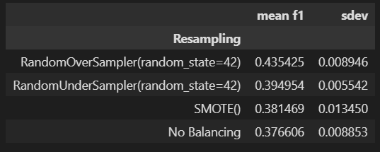

Data Rebalancing Algorithm Comparison
XGBoost
Method:
Stratified 5-Fold Cross-Validation
Result:
LightGBM significantly outperform XGBoost when using Random Over Sampler (ROS) and Random Under Sampler (RUS), but slightly underperforms with SMOTE and no data rebalancing
Universally, models with ROS and RUS outperforms those with SMOTE and no data rebalancing
Hence, LightGBM is superior to XGBoost for our modelling purpose
Conclusion:
Proceed with LightGBM*
LightGBM
*LightGBM (Light Gradient Boosting Machine) is a gradient boosting algorithm originally developed by Microsoft, which builds an ensemble of decision trees sequentially to create a strong learner.

Slide 50


Data Rebalancing Test Data
Algorithm Used:
LightGBM with Dataset 1
Result:
The best performing data rebalancing methods are Random Over Sampler and Random Under Sampler, significantly outperforming SMOTE and no data rebalancing
At the Default Threshold (0.5), the max F1-Score is 0.49 with recall of 0.64 using Random Over Sampler
Let’s see the graph of the ROS, RUS and SMOTE

Slide 51


Data Rebalancing Test Data – Graph Comparison
1
SMOTE has the highest peak F1 Score at around 0.52
Random Over Sampler
But, SMOTE has significantly lower recall compared to the other rebalancing methods
(very unideal)
2
Random Under Sampler
ROS and RUS performs very similarly, but ROS have better F1 Score due to having better Precision while maintaining about the same Recall as RUS
3
SMOTE
Conclusion:
Proceed with
Random Over Sampler

Slide 52



Hyperparameter Tuning
Model Pipeline:
Preprocessing : Transformer
Resampling : Random Over Sampler
Algorithm : LightGBM
Methodology:
Grid Search
Default Hyperparameters:
`max_bin` = 255
`num_leaves` = 31
`min_data_in_leaf` = 20
`num_iterations` = 100
`learning_rate` = 0.1
Best Model Hyperparameters:
`max_bin` = 255
`num_leaves` = 36
`min_data_in_leaf` = 25
`num_iterations` = 75
`learning_rate` = 0.05

Slide 53
Modelling 2 Final Model
Dataset 1 vs Dataset 5
Split: 80% Train Set, 20% Test Set

Slide 54

Dataset 5 Feature Selection
Based on the Feature Importance of Initial Best Model,
The Top 8 features:
`euribor3m`
`age`
`campaign`
`education`
`poutcome`
`contact`
`nr.employed`
`cons.conf.idx`
During the initial Feature Selection, we concluded that:
Multicollinearity (with & keeping `cons.price.idx`)
`emp.var.rate`
`euribor3m`
`nr.employed`
Statistically Not Significant:
`housing`
`loan`
Actually the most important feature

Slide 55
Dataset 5 Feature Selection
Feature Selection for Dataset 5:
`euribor3m`
`age`
`campaign`
`education`
`poutcome`
`contact`
`cons.conf.idx`
Treatment:
Missing Value Handling
Outlier Handling

Slide 56



Dataset 1 vs Dataset 5 Model Comparison Stratified 5-Fold Cross Validation
Algorithm Benchmarking
Data Rebalancing
Top 2 Best Algorithms
Still the best
XGBoost
LightGBM
Higher in Dataset 1
Dataset 1
Higher in Dataset 5
XGBoost
LightGBM
Dataset 5

Slide 57

Final Model Evaluation
Translation:
e.g., Out of 1000 people, there are 100 interested clients (Target).
65 Targets (65% Recall) are identified (predicted) as ‘interested’ by the model, the remaining 35 is wrongfully identified as ‘not interested’
The 65 Targets only make up 41% (Precision) of the list of predicted ‘interested’ clients; the rest (59%) are actually not interested
Model Low Performance is due to the Dataset, which characteristics are:
Not enough important Features to distinguish Target better
No Timestamps (year of data is missing despite taken from 2008-2013)
Heavily imbalanced dataset to predict
[Additional] Other projects (Research Article & Kaggle) share similar performance when using the same dataset

Slide 58


Final Model Evaluation Threshold Recommendations
1
2
X
Best Precision – Recall Balance
X
1
Threshold = 0.33 – Better Recall
2
Threshold = 0.6 – Better F1 Score
Use Case:
Stakeholders would like to get at least 80% of Target detected (recall >= 0.8) regardless of the precision
Use Case:
Stakeholders would like a more robust version of the model that can get at least 60% of Target detected (recall >= 0.6)

Slide 59
Data Analysis

Slide 60
Data Analysis
What are the most important characteristics that influence clients’ interest to subscribe to term deposits?
Based on Feature Importance of Final Model, the top 8 most Important Features are:
`euribor3m` : Euribor 3 Month Rate (daily indicator)
`age` : Age of Client
`campaign` : No. of times client was contacted during the campaign
`education` : Education Level of Client
`poutcome` : Outcome of Previous Campaign
`contact` : Communication Channel for contact to Client
`nr.employed`* : Avg. total number of Employed Citizen (Quarterly Indicator)
`cons.conf.idx` : Customer Confidence Index (CCI) (Monthly Indicator)
Note: Since `nr.employed` has correlation with `euribor3m`, we will not analyse the feature

Slide 61



1. Euribor 3 Months Rate (`euribor3m`)
1
Total Clients Contacted
67%
1
67% of Calls made to Clients are during High Rates
32%
<1%
71% of Clients who subscribed were contacted during Low Rates
Low Rates
(0-2%)
Mid Rates
(2-4%)
High Rates
(4-6%)
2
2
Number of Clients that Subscribed
Clients contacted during Low Rates (24%) is almost 5 times more likely to subscribe than those contacted at High Rates (5%)
3
71%
29%
<1%
29%
Recommendations:
Shift focus from calling during High Rates (4-6%) to maximizing all calls during low rates (0 -2%)
Do more calls during Mid Rates (2-4%) to gather more data
Low Rates
(0-2%)
Mid Rates
(2-4%)
High Rates
(4-6%)
3
Subscription Rate
24%
71%
14%
29%
5%
Low Rates
(0-2%)
Mid Rates*
(2-4%)
High Rates
(4-6%)
*Subscription Rate data for Mid Rates are too small to trust (only 14 calls or 0.03% of total calls)

Slide 62



2. Client Age (`age`)
1
Total Clients Contacted by Age
1
Most Calls are made to clients within the Age of 20-40 (55%)
Distribution of Clients’ age who subscribed is like that of the total clients contacted
2
Clients at the age of 20-40 are 1.3 times more likely to subscribe than those at the age of 40-60
2
3
Number of Clients that Subscribed
Clients at the age of >60 has the potential to be at least 3 times more likely to subscribe than those at the age of 20-40
(more data is needed)
56%
4
<1%
3
33%
8%
<2%
<20 20-40 40-60 60-80 >80
Recommendations:
Prioritize more on marketing to clients aged 20-40 years, but still maintaining those aged 40-60 years
Do more calls to Clients with age above 60 and below 20 to gather more data
3
4
Subscription Rate
45%
12%
38%
51%
9%
<20* 20-40 40-60 60-80 >80*
*Subscription Rate data for <20 and >80 are too small to trust

Slide 63



3. No. of Calls made to client (`campaign`)
Total Clients Contacted by No. of Calls Made
Most clients are contacted only once (43%), and gradually decreases in proportion with more calls made
1
1
43%
25%
Distribution of Clients who subscribed based on no. of calls made is like that of the total clients contacted
13%
2
1 2 3 4 5 6 7 8 >8
Subscription Rate peaked when clients are only called once at 13%, and continues to decrease along with more calls made
Number of Clients that Subscribed
3
49%
2
26%
12%
Recommendations:
Stakeholders should decide on the probability threshold to deem the client not worth continue pursuing to limit number of calls made
1 2 3 4 5 6 7 8 >8
Subscription Rate
3
10
5
0
13%
11%
11%
9%
8%
8%
6%
6%
4%
1 2 3 4 5 6 7 8 >8

Slide 64



4. Education Level (`education`)
Total Clients Contacted by Education level
Most clients contacted are generally higher educated
1
1
Distribution of Clients’ education level who subscribed is similar to that of the total clients contacted
30%
23%
5%
2
13%
15%
10%
<1%
4%
Higher education level is a contributing factor in increasing the likelihood for the client to accept subscription to term deposit
Number of Clients that Subscribed
3
2
36%
45%
22%
13%
10%
4%
9%
<1%
5%
Recommendations:
Prioritize marketing to clients with high education levels.
Subscription Rate
3
15%
22%
15%
11%
11%
8%
8%
10%
*Subscription Rate data for ‘illiterate’ are too small to trust, and ‘unknown’ is not inferable

Slide 65



5. Previous Campaign Outcome (`poutcome`)
Clients not contacted on previous campaign is the majority of those who are contacted & those who currently agree to subscribe
Total Clients Contacted by Prev. Outcome
1
86%
Clients who disagreed to subscribe on the previous campaign are contacted 3 times as much than those who agreed, despite those who agreed making up 1.5 times as much clients who subscribed on the current campaign than those who disagreed.
10%
3%
2
1
2
Number of Clients that Subscribed
Clients who agreed to subscribed to a term deposit during the previous campaign is 4.6 times more likely to agree to subscribe again compared to those who decline during the previous campaign , and 7.2 times more likely than those who never got contacted at the previous campaign
67%
13%
3
19%
Subscription Rate
3
Recommendations:
Maintain contacting new clients not approached on previous campaigns to get more subscriptions
Prioritize contacting those who agreed to subscribe previously rather than those who disagreed
14%
65%
9%
11%

Slide 66



6. Communication Channel (`contact`)
Total Clients Contacted by Communication Channel
Most calls are made via cellular, and most clients who subscribed are also called via cellular
63%
1
37%
Clients who were contacted via cellular are 3 times more likely to agree to subscribe to a term deposit than those who were contacted via telephone
1
Number of Clients that Subscribed
2
83%
17%
Recommendations:
Prioritize contacting clients via cellular, and only via telephone if there are no other way to contact them
Subscription Rate
2
15%
5%

Slide 67



7. Consumer Confidence Index (`cons.conf.idx`)
All calls were made during pessimistic period towards financial institutions (negative index), with most calls were made between
-45 to -35 CCI (middle range)
Total Clients Contacted by CCI
1
86%
1
Most clients who subscribe are also in the middle range, with 60% of clients who subscribed are during CCI above -40.8
2
Number of Clients that Subscribed
There is a rise in subscription rate with higher CCI, starting from CCI of -40.8 at 37%
3
40%
60%
2
Subscription Rate
Recommendations:
Prioritize marketing during more optimistic period (> -40.8 CCI)
37%
3
11%

Slide 68
Conclusion & Recommendations

Slide 69

Final Model
Dataset & Important Features
Features:
`euribor3m`
`age`
`campaign`
`education`
`poutcome`
`contact`
`nr.employed`
`cons.conf.idx`
`day_of_week`
Treatment:
`job`
`month`
`cons.price.idx`
`default`
`marital`
`housing`
`loan`
`emp.var.rate`
`previous`
Missing Value Handling
Outlier Handling
Feature Selection (excluding `duration` and `pdays`)
Duplicates Removal
Dataset Recommendations:
Increase more Features in dataset, such as:
Client Demographic
Agent Experience
Add Timestamp to the dataset
Provide cleaner dataset (no Missing Values)

Slide 70
Final Model
Modelling
Algorithm : LightGBM
Data Rebalancing : Random Over Sampler
Hyperparameters:
`max_bin` = 255
`num_leaves` = 36
`min_data_in_leaf` = 25
`num_iterations` = 75
`learning_rate` = 0.05
Default Threshold (0.5)
Modelling Recommendations:
Try more algorithms
Try more Hyperparameters for tuning

Slide 71
Final Model Profit Opportunity
Example Case
Assumption:
Bank XYZ has 8000 clients in total
Only 880 (11%) would be interested to subscribe to a term deposit if contacted
Maximum Capability for calls by bank Contact Center is 4000 clients each year
Case 1: Without Model
Recall : 50% (Random Chance) -> 440 interested clients contacted and agree to subscribe each year
Case 2: With Model
Recall : 65% -> 572 interested clients contacted and agree to subscribe each year
Case 2 contacted 132 more interested clients than Case 1
Based on the paper by Bikker and Gerritsen (2018), the minimum balance for a time deposit between 2003 – 2014 is approximately 500 euros minimum
Using the model, we generate extra 66.000 euros (132 x 500) of regulatory capital in minimum per year
Source: https://onlinelibrary.wiley.com/doi/full/10.1111/irfi.12143

Slide 72
Final Model Threshold Recommendations
1
2
X
Best Precision – Recall Balance
X
1
Threshold = 0.33 – Better Recall
2
Threshold = 0.6 – Better F1 Score
Use Case:
Stakeholders would like to get at least 80% of Target detected (recall >= 0.8) regardless of the precision
Use Case:
Stakeholders would like a more robust version of the model that can get at least 60% of Target detected (recall >= 0.6)

Slide 73
Important Characteristics Based on Feature Importance & Data Analysis

Slide 74
Tableau Dashboard

Slide 75

Tableau Dashboard - Structure
Part 1 is to provide overview to telemarketing manager and allow manager to make decisions
Part 2 is to allow data scientists to track feature changes over time to identify drift that could interfere with model
Based on most important features from LGBM

Slide 76
Tableau Dashboard - Structure
Part 1 is to provide overview to telemarketing manager and allow manager to make decisions
Part 2 is to allow data team to track feature changes over time to identify drift that could interfere with model
Based on most important features from LGBM

Slide 77
Tableau Dashboard Part 1 - Overview of Deposit Subscription
Left part allows quick look at current subscription rate
Right part helps the telemarketer to adjust the number of contacts during current campaign based on previous campaign outcome of client
e.g. if client poutcome is nonexistent, it is better to not make more than 2 calls

Slide 78
Tableau Dashboard Part 2 - Related to Features to Identify Drift
Change in age over months
Change in education during two recent months
Changes in two most important economic indices (Euribor and confidence index) over months

Slide 79
Thank You!

Slide 80

Extra Info for QnA

